Slide 1

STARBUCKS
Team sharks_
Shivang Mistry
Saumil Shah
Sarath Vattikuti
Sandeep J

Slide 2

Technology Stack

Slide 3
APIs
Login
Sign Up
Profile
Add Card
Post Payment
Order

Slide 4
Implementation
Created a Web UI and deployed it on Heroku.
Deployed APIs to AWS as Docker EC2 instance.

Slide 5
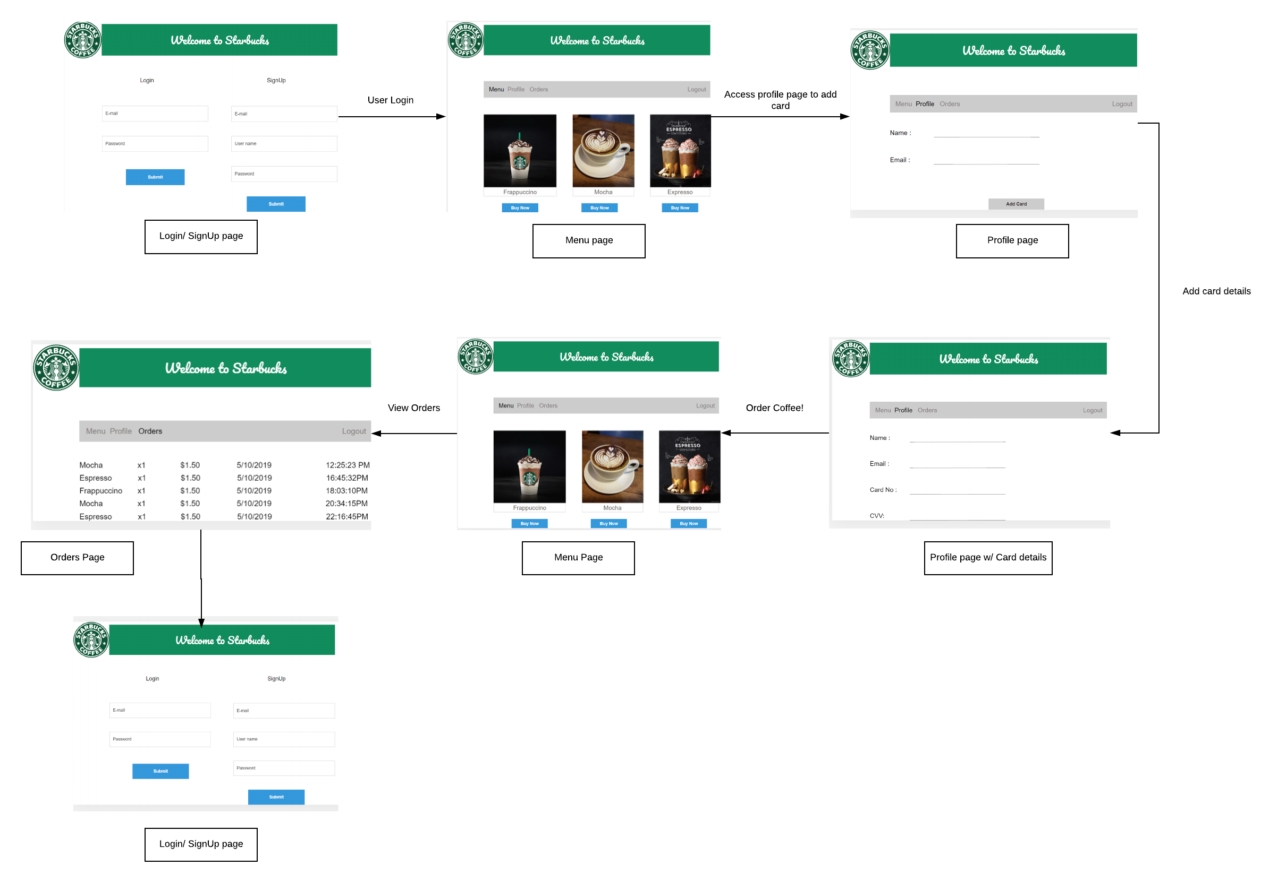
User Flow

Slide 6
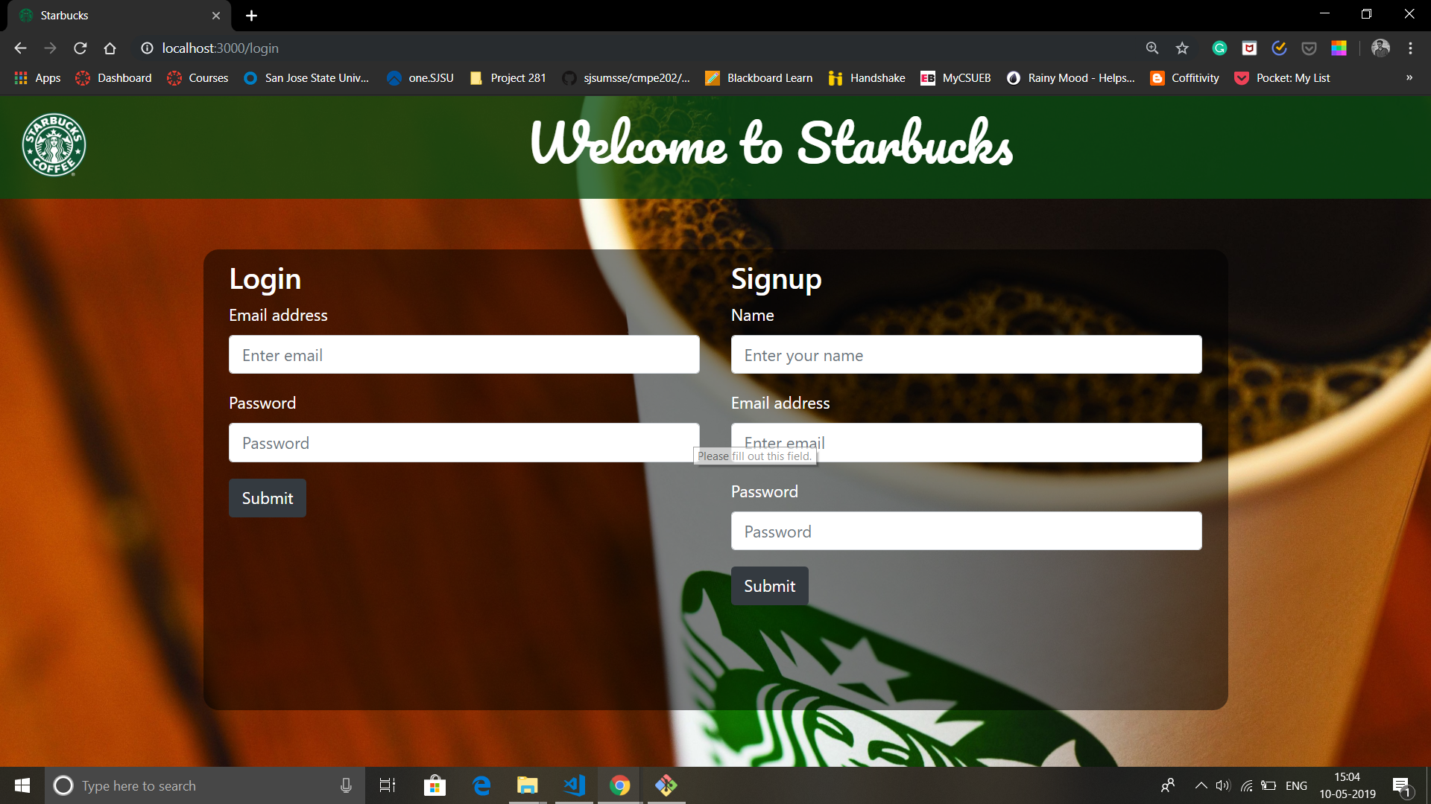

Slide 7
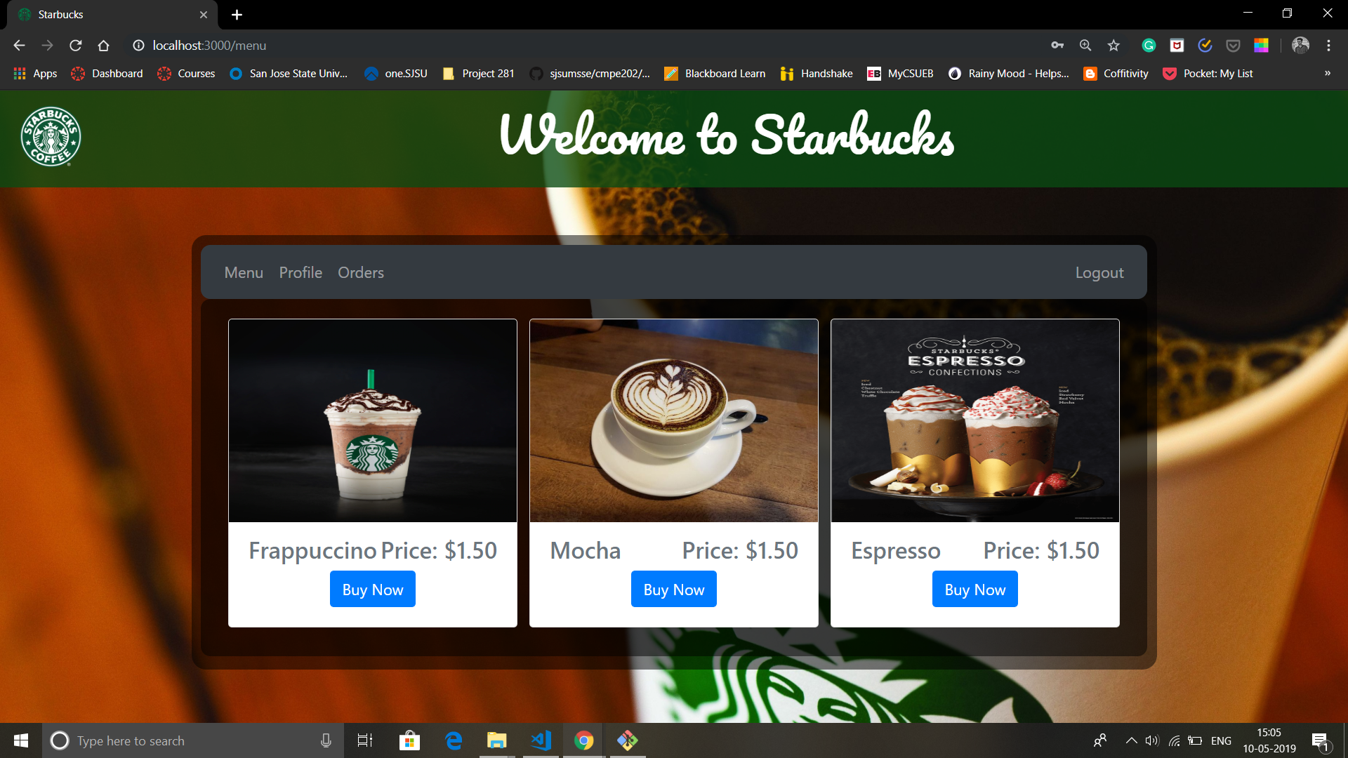

Slide 8
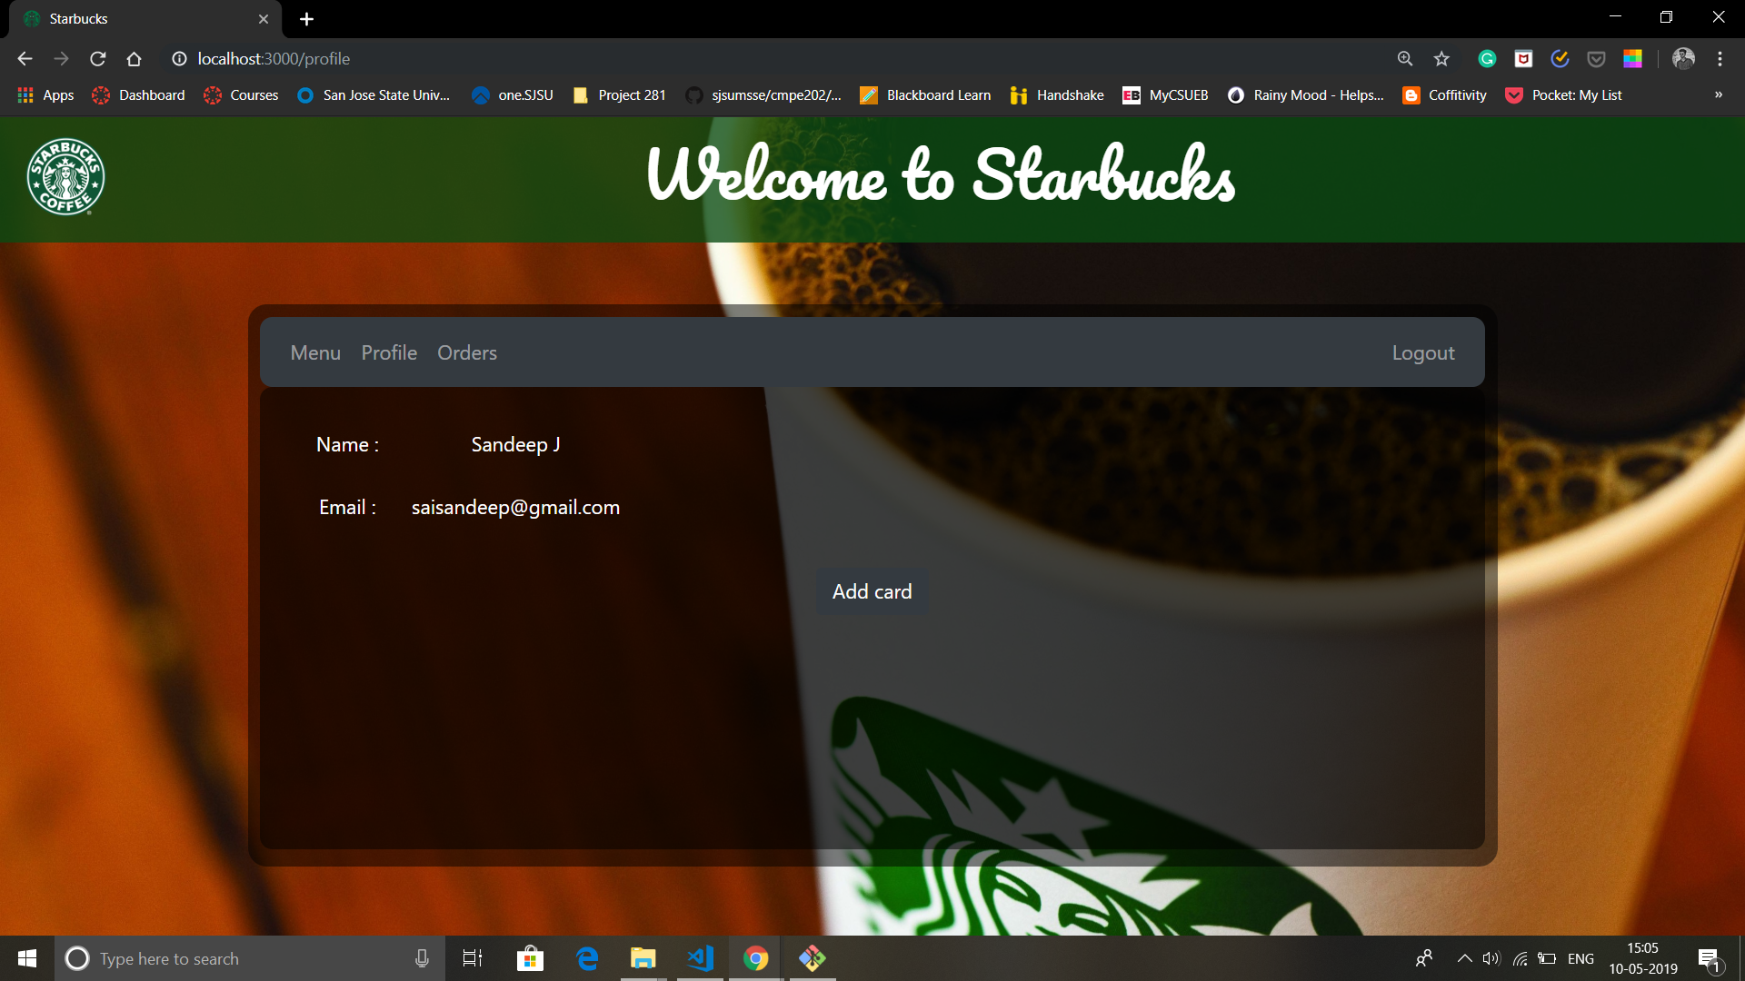

Slide 9
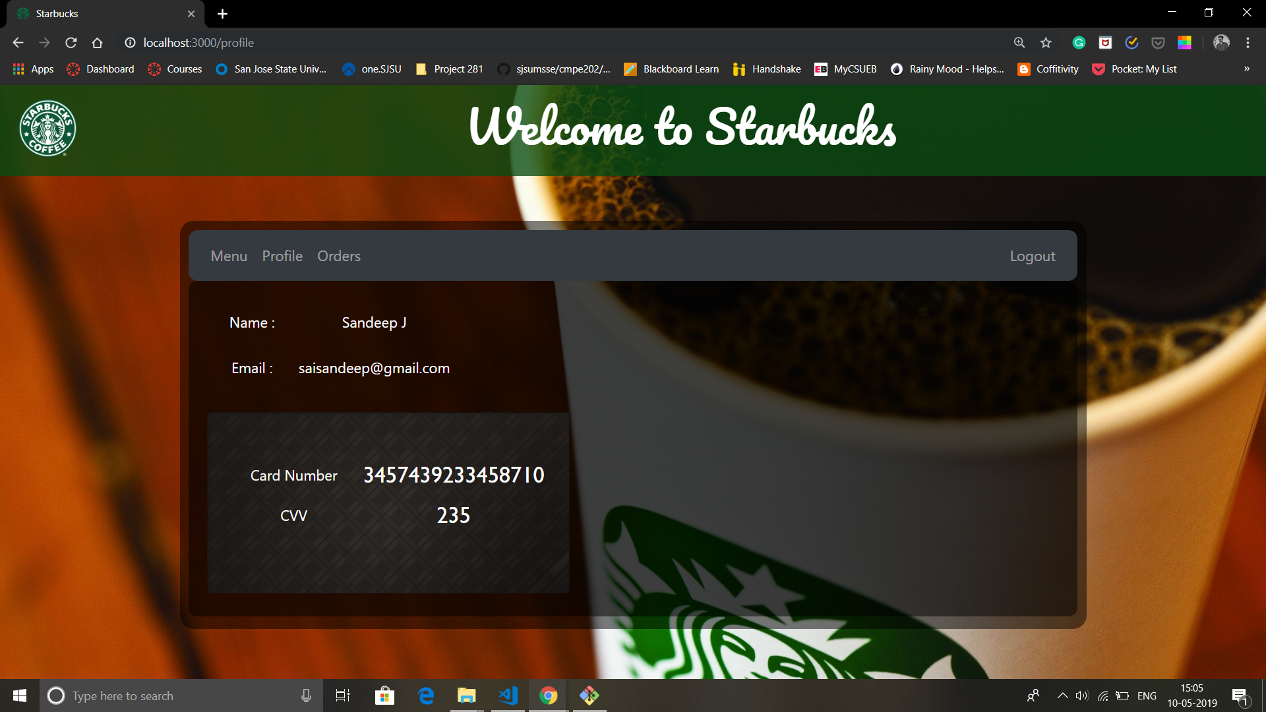

Slide 10
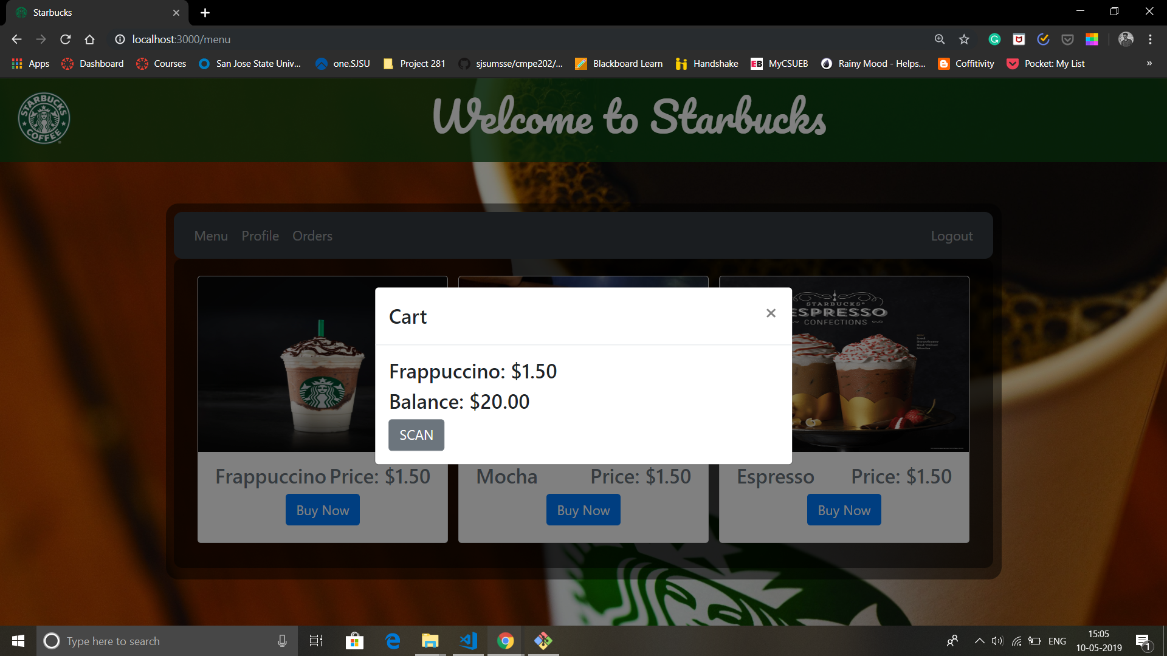

Slide 11
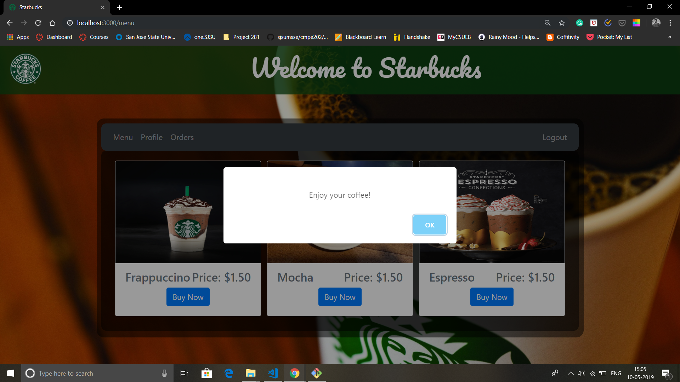

Slide 12
